Slide 1
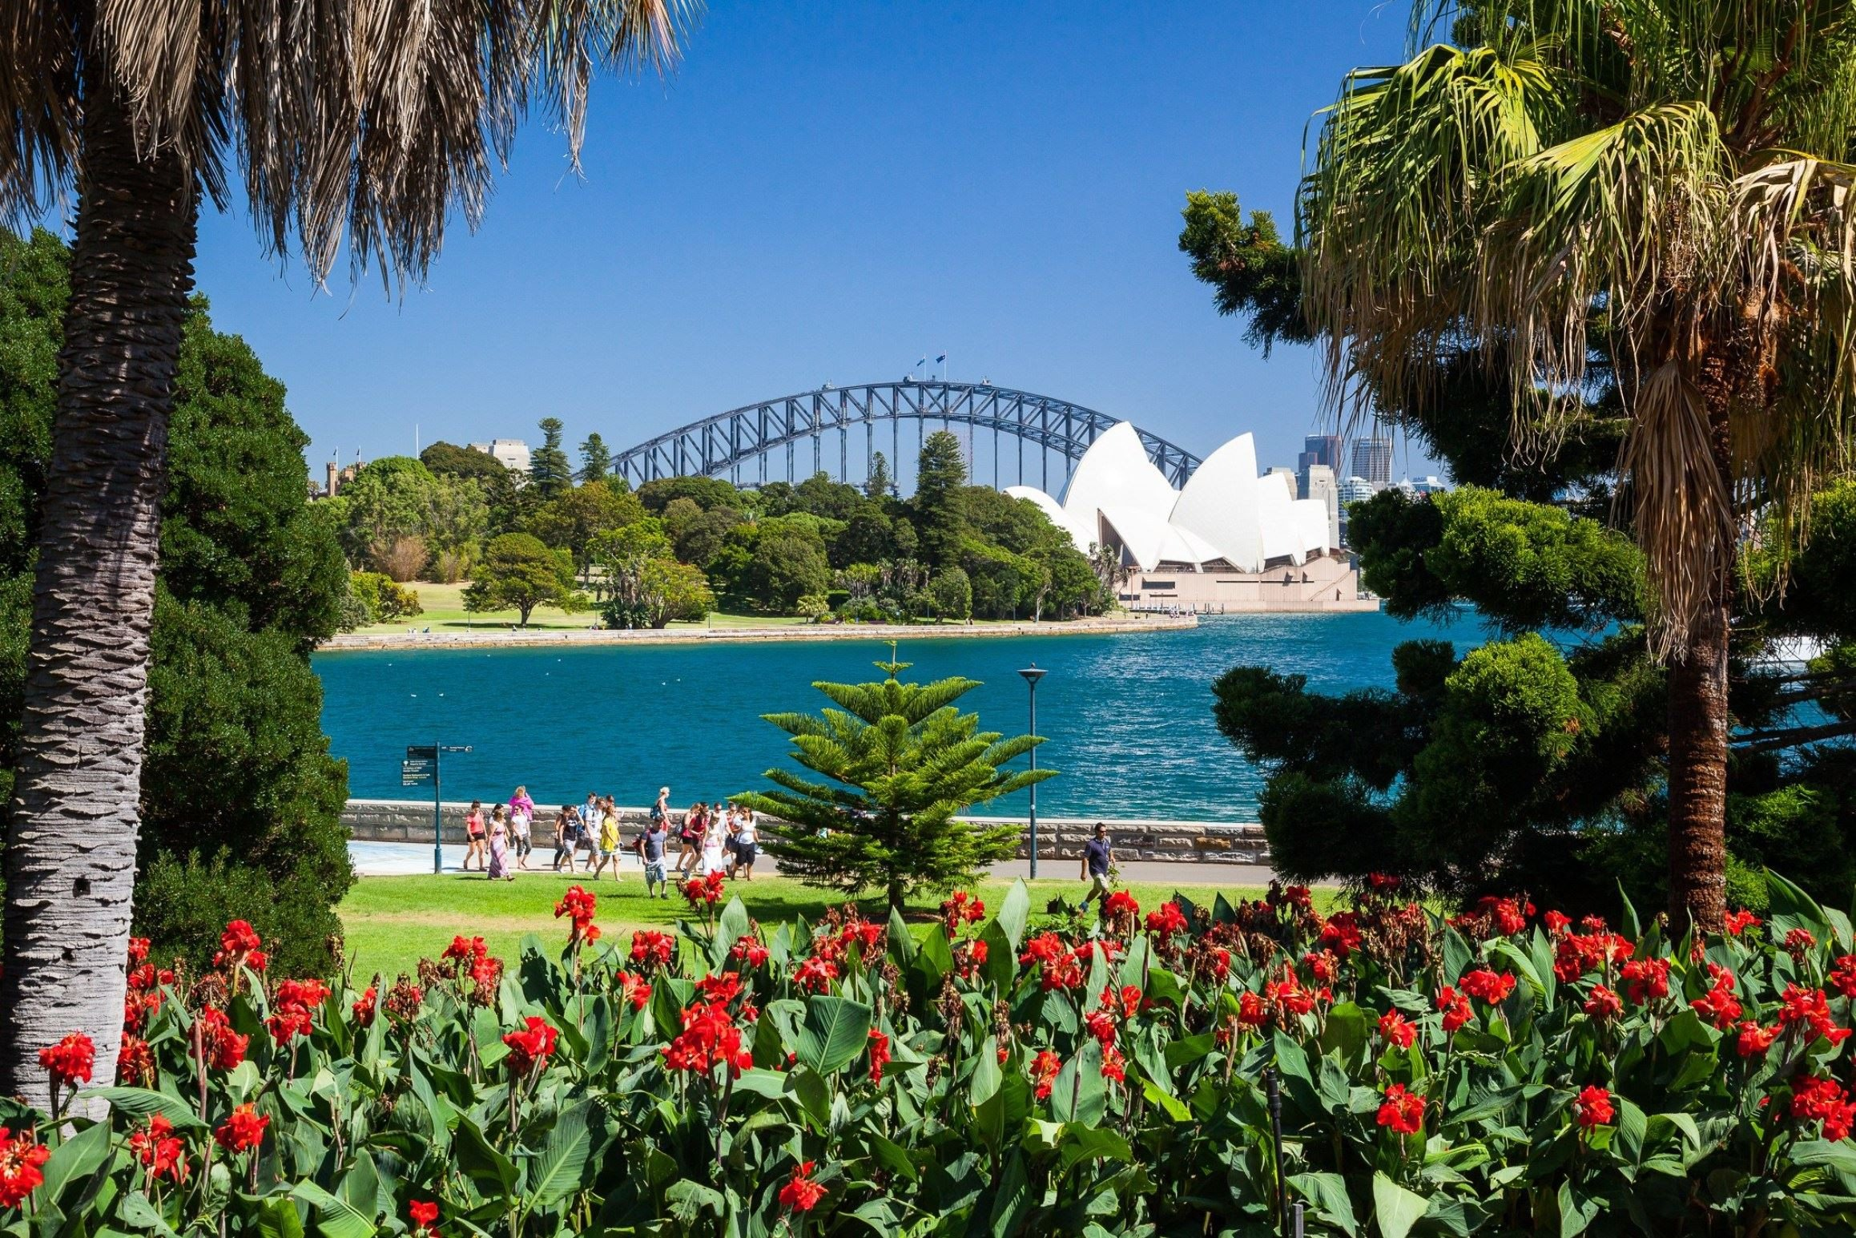
What do you like most about Sydney?

Slide 2
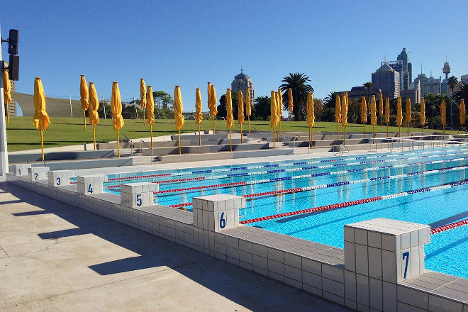
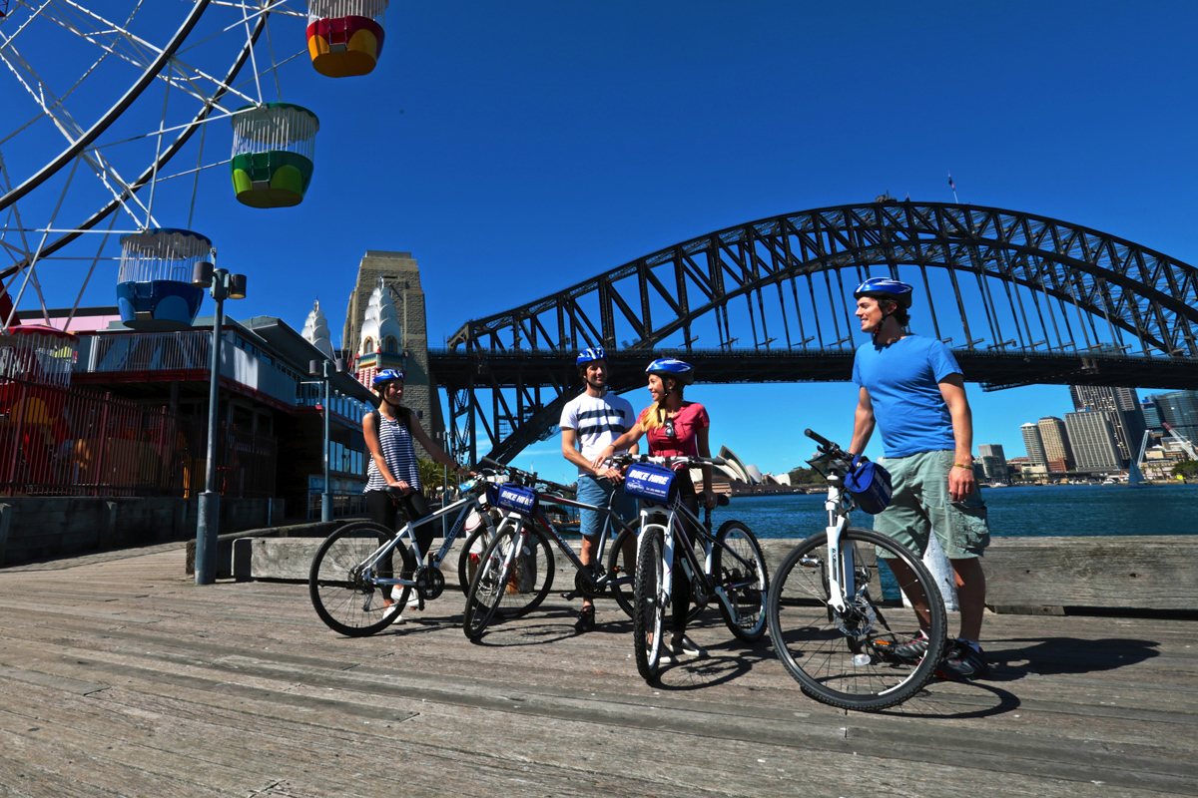
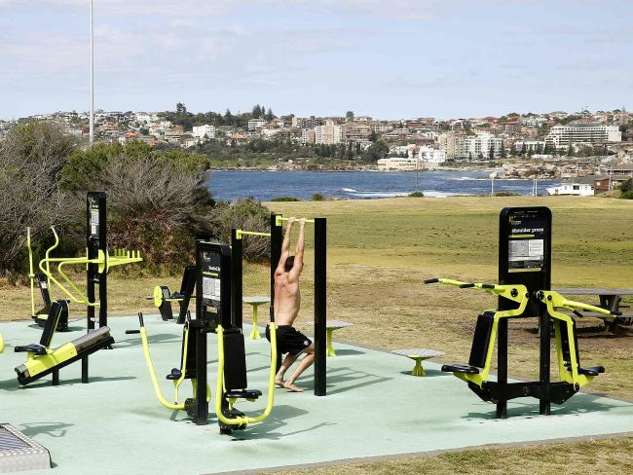

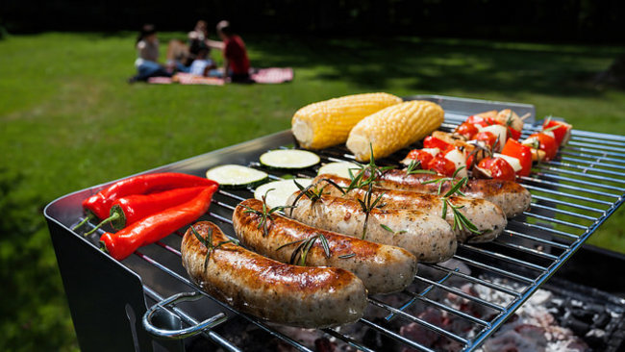

Slide 3





POTENTIAL PROBLEMS
Information in different places
Too much time wasted doing research
Partial existent solution
Image courtesy cityofsydney.nsw.gov.au
Image courtesy sydney.com
Image courtesy northernbeaches.nsw.gov.au
Image courtesy Google.com
Image courtesy northsydney.nsw.gov.au

Slide 4
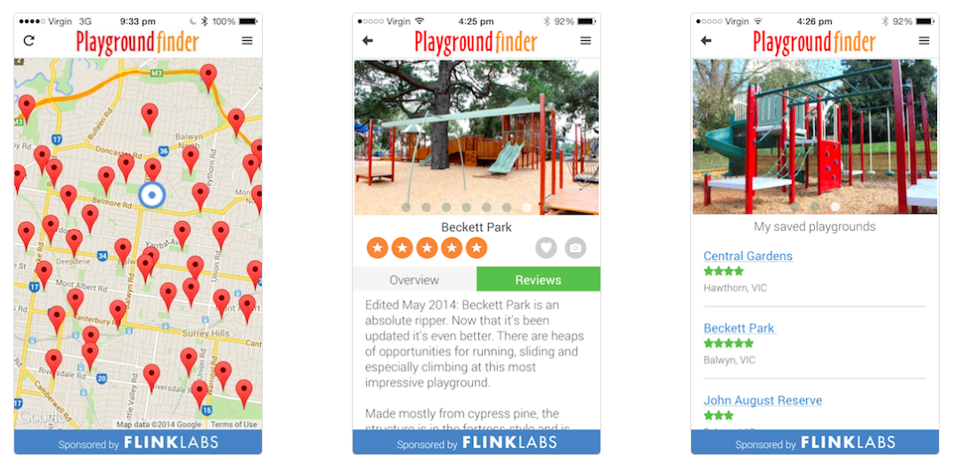
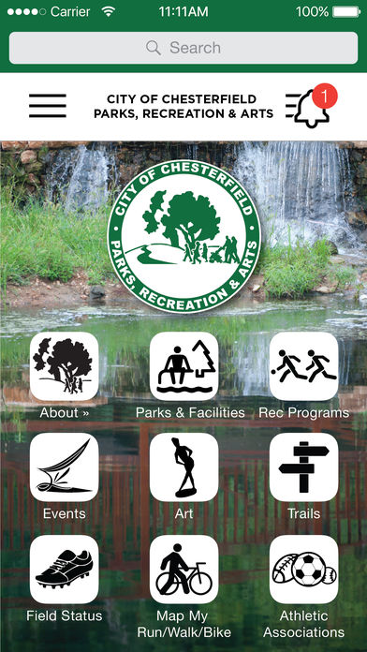
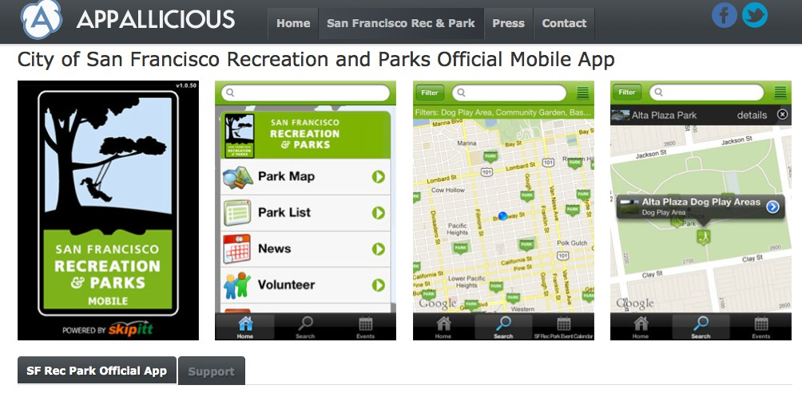
RESEARCH
Existing Solutions
Image courtesy playgroundfinder.com
Image courtesy Group US LLP
Image courtesy SFexaminer

Slide 5
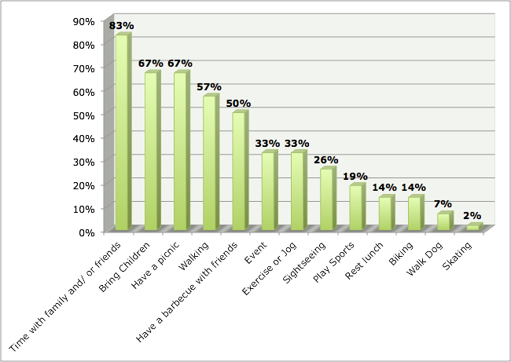
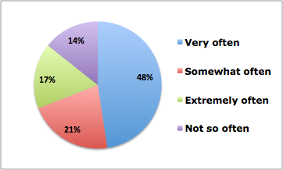
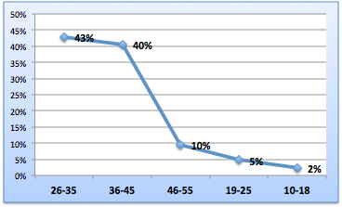
SURVEY
How often do you visit the public parks in Sydney?
Why do you go to the Park?
How old are you?
50 Responses
The survey revealed that people like to go to the Park with their family and friends.
Almost half of the respondents, said that they go to the Park very often.
The target audience will be between 25 - 45 years old

Slide 6
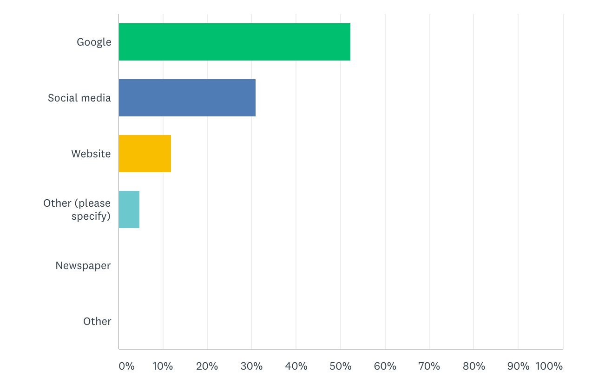
SURVEY
Which tool to you use to find information about parks?
Image:www.surveymonkey.com

Slide 7
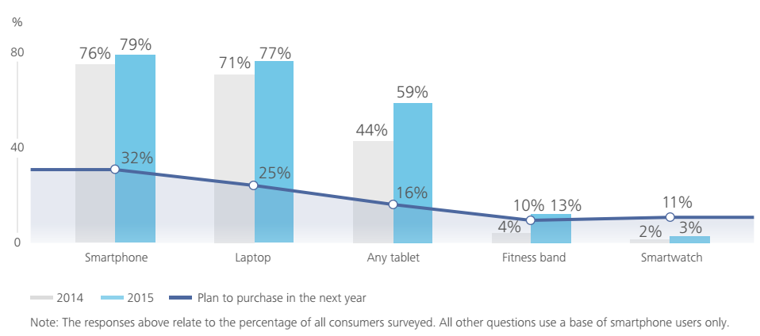
MARKET RESEARCH - DEVICES
The smartphone is the dominant device for all users under 55 and 79% of Australians own one.
Image: landing.deloitte.com.au/

Slide 8
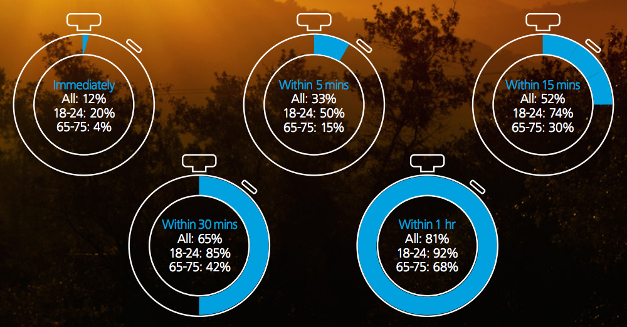
MARKET RESEARCH
Over 80% of the population checks their phones within the first hour after waking up
How quickly do you check your smartphone after waking?
Image: landing.deloitte.com.au/

Slide 9
RESEARCH ANALYSIS
Real Problems
Target Audience
➔ Families
➔ Tourists
➔ Outdoor Enthusiast
➔ Fitness people
➔ Ages 25 to 45
➔ Both gender
Target Devices
➔ Mobiles
➔ Smartphones
➔ Android
➔ IOs
➔ Windows Phone

Slide 10
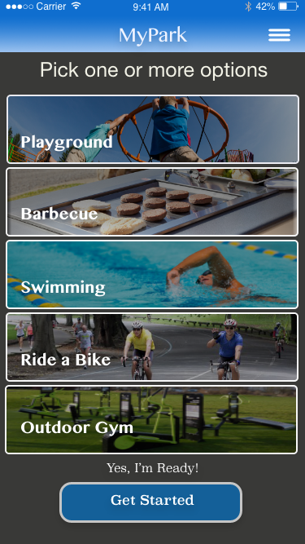
MyPark app
All Sydney Parks close to you.
“ Discover great Parks areas
and opportunities.
”

Slide 11

FEATURES

Slide 12
POTENTIAL BUSINESS MODEL
Sell Advertising space
Promote Products as an Affiliate
Promote coffee shop or restaurant near park
Sell Collected Data
Image: landing.deloitte.com.au/

Slide 13
DEVELOPMENT PLAN
Phases of development
Trainning 2 weeks
Implementation 8 weeks
Tests 3 weeks
Fast-paced mode

Slide 14

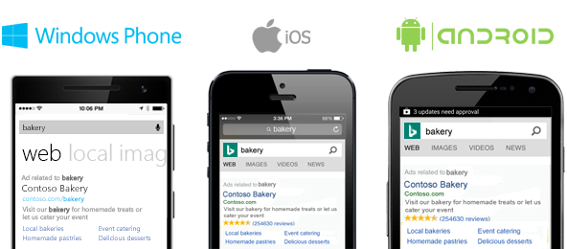
DEVELOPMENT TECHNOLOGY
Cross Platform
Low Learning Curve
Image courtesy by Avocarrot Blog

Slide 15


Slide 16
Thank you!

Slide 17
REFERENCES
Survey Monkey 2017, viewed 21 September 2017,
<https://www.surveymonkey.com>
Mobile Consumer Survey 2016, The Australian Cut– Hyper Connectivity: Clever Consumption, viewed 10 September 2017,
<https://www2.deloitte.com/au/en/pages/technology-media-and-telecommunications/articles/mobile-consumer-survey-2016.html>
Ionic Framework 2017, viewed 10 September 2017,
<https://ionicframework.com/>

